Slide 1


Advanced Analytics
Please mute yourself. Thank you!

Slide 2
Learning Objectives
You will learn the following concepts:
Advanced Analytics
Data Insights through AI Visuals
Notes:
By the end of this module, you’ll be able to:
Use advanced analytics to explore statistical summary, identify outliers, conduct time-series analysis, and more.
Uncover additional data insights through the use of AI visuals

Slide 3
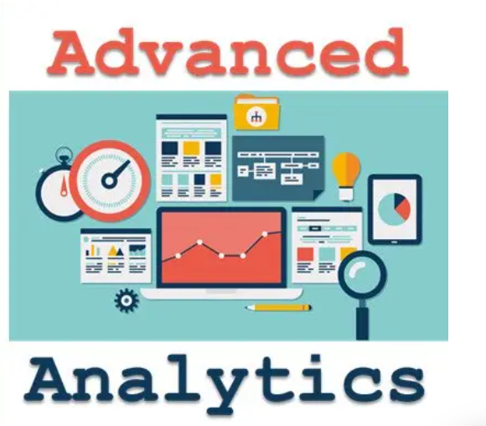
Introduction to Advanced Analytics
Advanced analytics enables organizations to make better business decisions and create actional and meaningful insights.
The emerging power of advanced analytics.
Bring value to an organization through Power BI’s advanced analytics capabilities.

Slide 4
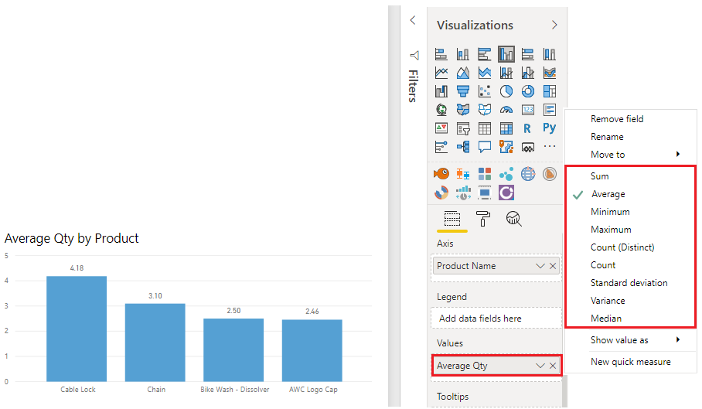
Explore Statistical Summary
Information that provides quick and simple description of your data.
See clusters, patterns, and behavioral data.
Notes:
Data is often intertwined with statistics, for statistics are one way in which you can explore your data. Statistics show you the distribution of your data, and help you to identify key takeaways and trends, and see if there are any outliers.
The statistical summary is the information that provides a quick and simple description of your data. Power BI has many functions that help you to carry out a statistical analysis, such as Data Analysis Expressions (DAX) functions, visuals such as histograms and bell curves, advanced analytics visuals, and statistical programming languages such as Python and R.
Exploring the statistical summary gives the end-user a high-level view of the available data, where they can see clusters, patterns on behavioral data, data averages and more. They can gain insights about their data that will drive business decisions.
Critical statistical functionality in Power BI include:
Statistical Functions: DAX functions that you can use to get quick statistics based on your data. You can access these quick functions by right-clicking on value field in the Visualizations pane.
Histograms: A representation of data points into ranges. Histograms and bell curves are the most common way to display statistics about your data sets.
Top N analysis: The TOPN DAX function returns the top N rows of a specified table. The top N analysis is a great way to present data that might be important, such as the top 10 lists.
Q&A visual: The Q&A visual is an effective tool, as it allows users to quickly get answers about the data independently, which saves time for everyone involved.
Top N filter type: Top N is a filtering option available on the Filters pane which is useful to display the top or bottom N in a list.
You can also calculate your Top 10 Products in DAX, using the TOPN function. This option could very useful if you want to present the top 10 in a different context, such as how much of the top 10 best-selling products contributed towards the overall total sales.

Slide 5
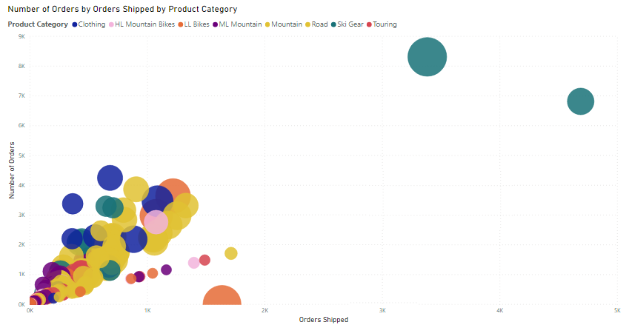
Identify Outliers
The scatter chart displays outliers.
Notes:
An outlier is a type of anomaly in your data - something that you didn't expect or that surprised you, based on historical averages or results. You will want to identify outliers to isolate data points that significantly differ from other data points, then take action to investigate the reasons for the differences. The results of this analysis can make a huge impact on business decision making.
For example: You are analyzing data for a shipping warehouse. You notice that the number of orders spiked up above average for a specific product category. You first want to identify which product category it is and ask questions about the outliers.
Was there above average shipments that day?
Was it just a specific warehouse?
Did a single event cause the spike in orders for specific category?
Were there any other days like this in the last month, quarter, year, or prior year?
Power BI allows you to easily identify outliers in your data but you need to first determine the logic behind what constitutes an outlier. You can use trigger points, such as calculations, around what you would consider the outlier to be.
The process of identifying outliers involves segmenting your data into two groups; one group is the outlier data and the other group is not. You could use calculated columns to identify outliers but the results would be static until you refresh the data. A better way to identify outliers is to use a visualization or DAX formula, as these methods will ensure your results are dynamic.
Drilling into the outliers:
Use a visual: The best visual to use to identify outliers is the scatter chart, which shows the relationship between two numerical values. Scatter charts display patterns in large sets of data and are therefore, ideal for displaying outliers.
Use DAX: You can use DAX to create a measure that will identify the outliers in your data. When you have created a new outlier measure, you can group your products into categories using the grouping feature.

Slide 6
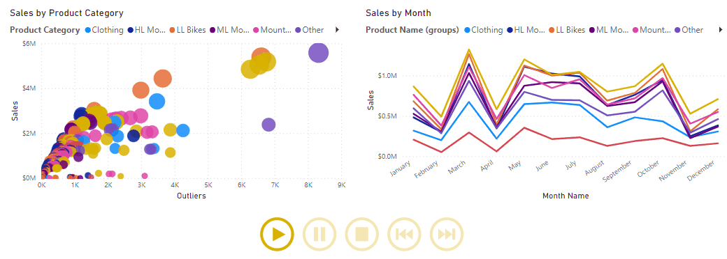
Conduct Time-series Analysis
Time series charts can be imported from AppSource.
Further, if your organization does not allow downloading from Appstore, you can instead use the Play Axis that is available for Scatter chart visualizations within Power BI Desktop, as it has similar functionality.
Analyze a series of data over time.
Identify meaningful trends and make predictions.
Notes:
Time series analysis involves analyzing a series of data in time order, to identify meaningful information and trends, and make predictions. The result of time series analysis is the best data you can use for forecasting activities.
Time series analysis often involves the use of visuals such as Gantt charts, project planning, and stock movement datasets. In Power BI, you can use visuals to view how your data is progressing over time, which in turn allows you to make observations, such as if there were any major events that disrupted your data.
To conduct a time series analysis in Power BI, you need to use a visualization type that is suitable for displaying trends and changes over time, such as a line chart, area chart or scatter chart. You can also import a time series custom visual into Power BI Desktop from the Microsoft AppSource.
NOTE: Some organizations prefer not to use custom visuals, for security or other reasons. Before you import any custom visuals, check with your organization to see if they are allowed or not. If they are not allowed, you can instead use the Play Axis that is available for Scatter chart visualizations within Power BI Desktop, as it has similar functionality.
The Microsoft AppSource has an animation custom visual called Play Axis that works like a dynamic slicer, and is an interesting way to display time trends and patterns in your data, without any user interaction.
Start by adding your visual to the report page.
Import the animation custom visual to use with your selected visual.
Select the page, then select the Play Axis icon to add that visual to the page.
Select the field that you want to use as the slicer in the Play Axis animation.
Animation controls are now available on the visual.

Slide 7
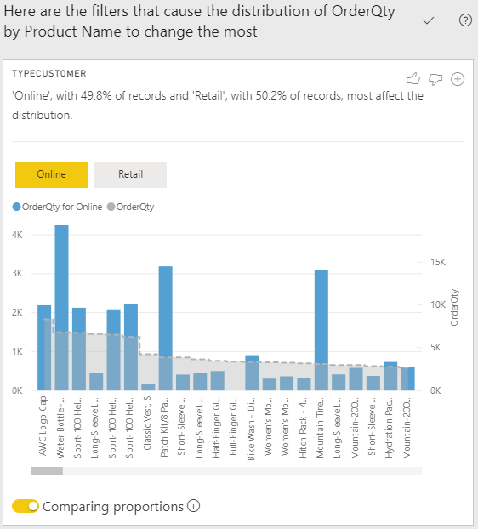
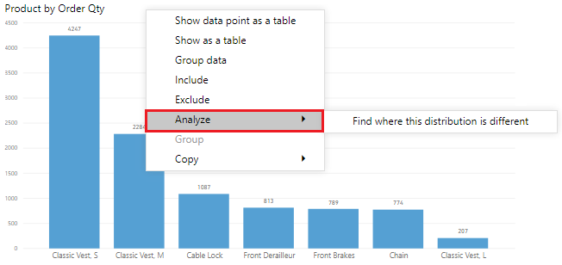
Using the Analyze Feature
Get fast, automated, and insightful analysis on your data.
Notes:
The Analyze feature provides you with additional analysis that is generated by Power BI for a selected data point. You might want to use this feature to see if Power BI has found something that you haven't looked at before, or if you want Power BI to give you a different insight to your data. This feature is particularly useful for analyzing why your data distribution looks the way it does.
Instead of exploring the data manually, you can use the Analyze feature to get a fast, automated, insightful analysis on your data.
NOTE: This feature will not work if you have non-numeric filters applied to your visual and/or if you have measure filters applied.
To use the Analyze feature, right-click a data point on the visual, then hover over the Analyze option to display two further options: Explain the increase and Find where the distribution is different. The options that are available will depend on the data point you selected.
You can add the new visual to your report, so other users can view it. Select the plus icon in the top right corner of the visual to add it to your report.

Slide 8
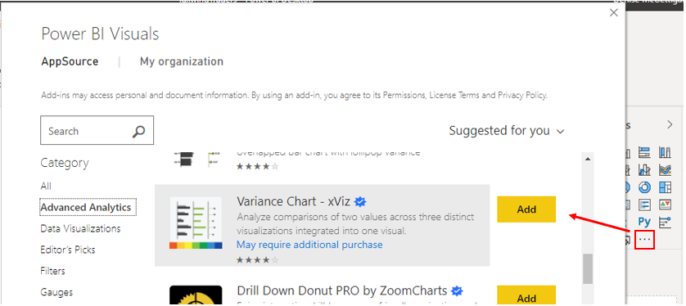
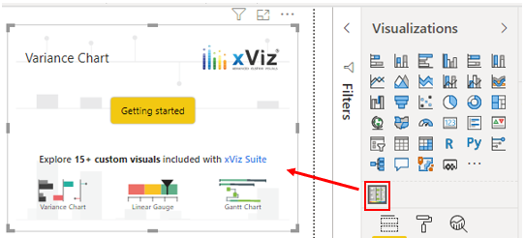
Advanced Analytics Custom Visuals
Add a layer of data insights to your reports for further analysis.
Notes:
In addition to the out-of-the-box visualizations you see in Power BI Desktop, the Microsoft AppSource has a vast library of custom visuals that you can import into Power BI Desktop. These custom visuals give you a wider choice of options when it comes to using advanced analytics. There might be a custom visual that solves a business problem that the standard visuals cannot solve, or one that presents your data in a way that the standard visuals cannot.
These custom visuals include box-and-whisker plots, variance charts, hierarchical trees, Gantt plots, clustering plots, and much more; the list goes on. Using advanced analytics visuals adds a layer of complexity to your reports, and allows you to further analyze the data and develop granularity within your visuals.
NOTE: Some organizations prefer not to use custom visuals at all, or only permit certain custom visuals, for security or other reasons. Before you import any custom visuals, check with your organization to see if they are allowed or not. If they are not allowed, you can still create reports in desktop with them, but they will not render in the Power BI Service.

Slide 9
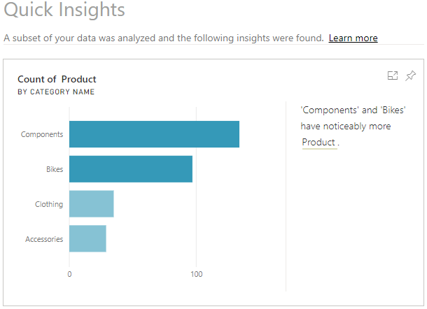
Quick Insights
Uses Machine Learning algorithms to produce quick insights.
Uncover insights missed during report construction.
Generate stimulating visual interactions.
Notes:
The Quick insights feature in Power BI uses machine learning algorithms to run over your entire dataset and produce insights (results) for you, very quickly. This feature is a great way to build dashboards, when you don't know where to start. It also helps you to determine any insights you might've missed when building out your reports. From the insights that Power BI discovers, you can generate interesting interactive visualizations.
NOTE: This feature is available in the Power BI Web Service only. Also, this feature doesn't work with DirectQuery; it only works with data imported to Power BI.
To get quick insights on your dataset, open your Power BI Web Service, then select the Content tab. Locate your report for which you want to get quick insights, then select More options (...) > Quick insights.
Power BI will use various algorithms to search for trends in your dataset. This process might take a few seconds but when it is finished, you'll see a message in the top right corner letting you know that the results are ready to be viewed.
Select View insights to open the Quick Insights page for the selected dataset and view the insights that Power BI found for you. The Quick Insights page contains up to 32 separate insight cards, and each card has a chart or graph, plus a short description.
Add the Quick Insights card to your report: If you see an insight card that is particularly interesting, you can add it to your report. On the Quick Insights page, hover over the card, then select the pin icon. The visual is added to your dashboard, where you can reposition it as required.
Interact with the results: To take a closer look at a particular insight card on the Quick Insights page, select an insight card to open the insight screen opens in Focus mode.
You can then perform the following actions:
Filter the visualization using the available options in the Filters panel.
Pin the insight card to a dashboard by selecting Pin visual.
Run insights on the card itself (scoped insights) by selecting Get insights in the top-right corner. The scoped insights allow you to drill down deeper into your data.
Return to the original insights canvas by selecting Exit Focus mode in the top-left corner.

Slide 10
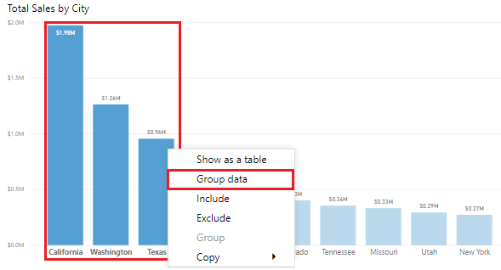
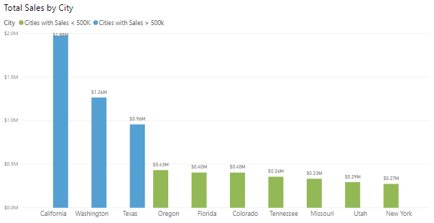
Grouping and Binning
Grouping: Group categories of data.
Binning: Group continuous fields.
Notes:
When you create visuals, Power BI Desktop aggregates your data into groups, based on the values it finds in the underlying data. You can refine how those default groups are presented. Group data points to help view, analyze, and explore data more clearly.
You can also create new groups by grouping two or more data points in a visual or putting values into equal sized groups (binning), that better enable you to visualized data in ways that are meaningful.
Grouping is used for categories of data. Binning is similar to grouping but it is used for grouping continuous fields, such as numbers and dates.
You can use the grouping and binning features to ensure the visuals in your reports display your data exactly how you want them to, so you can more clearly view, analyze, and explore the data and trends in your visuals. You'll be able to identify clusters, patterns of behavior, data averages, and more. The results of this analysis will provide your end-users with more specific insights on their data, which can drive business decisions.
Create a group: To create the group, you start by using Ctrl+click to select the data points on the visual that you want to group. Right-click one of those selected data points and select the Group data option.
When the group is created, you'll see that the visual updates to take account of the new group.
Easily edit existing groups by tight-clicking the field from the Legend bucket or from the Fields list, and then choose Edit Groups.
The process of binning allows you to group your numerical and time field data into "bins" of equal size, so you can visualize and identify trends in your data in more meaningful ways. Binning allows you to right-size the data that Power BI Desktop displays.

Slide 11
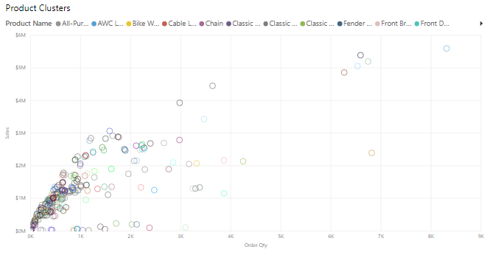
Clustering Techniques
Notes:
Clustering allows you to identify a segment (cluster) of data that is similar to each other but very dissimilar to the rest of the data. The process of clustering is different to that of grouping, which you did earlier.
The Power BI clustering feature allows you to quickly find groups of similar data points in a subset of your data. It analyzes your dataset to identify similarities and dissimilarities in the attribute values, then it separates the data that has similarities into a subset of the data. These subsets of data are referred to as clusters.
Start by adding the Scatter chart visualization to your report, then add the required fields to the visual.
To apply clustering to your scatter chart, select More options (...) in the top right corner of the visual, and then select Automatically find clusters.
On the Clusters window that displays, you can edit the default name, field and description, if required.
NOTE: Leaving the Number of clusters box is blank means Power BI automatically finds the number of clusters it thinks makes the most sense with your data.
The new cluster field is added to your scatter chart's legend field well bucket, which you can now use as a source of cross highlighting like any other legend field. You can also find it in your field list and use it in new visuals, just like any other field.

Slide 12
Review Questions (1)
Q01 – What Power BI feature can give an in-depth analysis of the distribution of data?
A01 – The Analyze feature allows a user to understand why the distribution of data looks the way it does.
Q02 – Where are time series charts located?
A02 – Time series charts can be imported from AppSource.
Q03 – What visual should be used to display outliers?
A03 – The scatter chart displays outliers.

Slide 13
Lesson Review (1)
Advanced analytics enables organizations to make better business decisions and create actional and meaningful insights.
The emerging power of advanced analytics.
Bring value to an organization through Power BI’s advanced analytics capabilities.

Slide 14
Lesson 2: Data Insights through AI Visuals

Slide 15

Introduction to AI Visuals
Power BI provides a wide range of methods to analyze data.
Fastest way to get an answer is to ask a question.
Analyze raw data and transform it into valuable information.

Slide 16
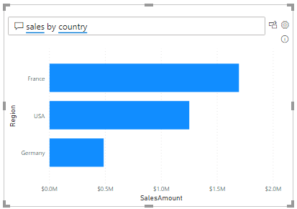
The Q&A Feature
Explore data in your own words.
Ask natural language questions.
A “self-help” feature for insights the user is interested in.
Notes:
The Q&A feature in Power BI lets you explore your data in your own words, by allowing you to ask natural language questions, and then answering those questions for you.
This ability to ask questions is valuable to both you, as the report author, and your report users. It gives you ideas for the type of visuals you can display in your report, and lets you quickly add those visuals. It gives your report users an effective tool they can use to get quick answers to their questions about the data, independently. This self-help aspect to Power BI saves time for everyone involved.
Power BI records all of the questions that are asked, and you can use this information to set up the Q&A feature to be more effective. When the Q&A feature answers so many questions, you'll have less people coming directly to you looking for those answers.
Set up the Q&A Feature:
You can set up the underlying Q&A feature so that it becomes better at answering questions about your data. You basically teach the Q&A feature to understand people better.
Proactively monitor and review the questions that are coming through from users, then and address misunderstandings or common typos.
Manage the key terms associated with your data, so you can add a library of synonyms that may be used by different users across the organization when asking questions about the data.
Fine-tune the Q&A feature, so it provides better answers to your organization's questions.
Build visuals with the Q&A feature:
When Power BI answers a question and you find the visual result interesting or helpful, you can add it as a standard visual on your report.
To turn a Q&A result into a standard visual, click the icon next to the question box.
The Q&A feature is unique in that it does not require knowledge of Power BI to use the visual, users simply have to ask their question and they too can create insightful visuals.

Slide 17
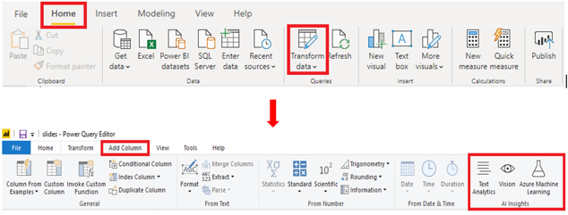
AI Insights
Connect to a collection of pre-trained Machine Learning models.
Notes:
The AI Insights feature allows you to connect to a collection of pre-trained machine learning models that you can apply to your data, to enhance your data preparation efforts.
AI Insights is accessed in the Power Query editor, and its associated features and functions are accessed through the Home and Add Column tabs in Power Query editor.
With Text Analytics and Vision in Power BI, you can apply different algorithms from Azure Cognitive Services to enrich your data in Power Query. The services that are supported today are the following:
Sentiment Analysis
Key Phrase Extraction
Language Detection
Image Tagging
NOTE: Premium capacity is required to use the Text Analytics and Vision options.
NOTE: If you do not see these options, you need to enable the AI Insights feature in the Power BI Desktop settings. Go to File > Options and Settings > Options. In the Global options list, select Preview Features, then select the check box for the AI Insights function browser option, and then select OK.

Slide 18
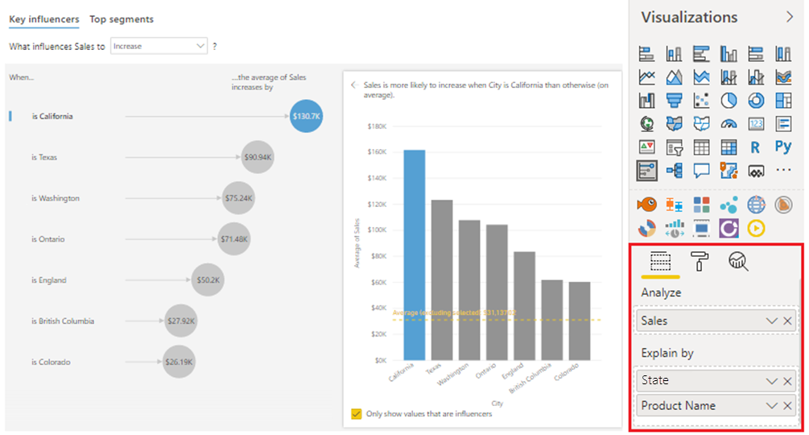
Key Influencer Visual
State
State
State
State
State
State
State
State
State
Notes:
The Key Influencers visual helps you understand the factors that are affecting a specific metric. It analyzes your data for you, ranks the factors that matter, and then displays those factors as key influencers. It also helps you to contrast the relative importance of these factors. This means that not only can you build your visuals, but you can also understand what factors impact those visuals, and why the visuals look the way they do.
To establish the key influencers, first add the Key Influencers visual to your report by selecting the Key Influencers icon on the Visualization pane. Then, populate the visual with the metrics you want to measure. The visual updates according to the fields you added, then shows the influence those fields have on your data.
You can now use the "What influences..." drop-down list to see what caused the data to decrease or increase.

Slide 19
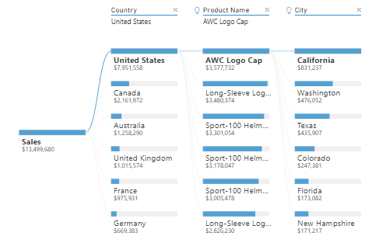
Decomposition Tree Visual
Aggregate data and drill down into your dimension.
Improvise exploration and root cause analysis.
Notes:
The Decomposition Tree visual automatically aggregates your data and lets you drill down into your dimensions, so you can view your data across multiple dimensions. Because the Decomposition Tree visual is an AI visual, you can use it for improvised exploration and conducting root cause analysis.
Add the Decomposition Tree visual to your report by selecting the Decomposition Tree icon on the Visualization pane. Then, in the Analyze field well, add the measure or aggregate you want to analyze, and the Explain By field well, add the dimension(s) that you want to drill down into. The visual updates according to the fields you added, and displays the analysis summary result.
At the top of the list of dimensions you added, you'll see two additional options, marked with lightbulb icons. These options are referred to as AI Splits and they'll find high and low values in the data automatically. The AI Splits work by considering all of the available fields and determining which one to drill into to get the highest/lowest value of the measure being analyzed. You can use the results of these splits to find out where you should look next in the data.

Slide 20
Review Questions (2)
Q01 – What does the AI splits feature do?
A01 – AI splits work by considering all the available fields and determining which one to drill into to get the highest/lowest value of a measure that is being analyzed.
Q02 – Can you access the Q&A feature by using buttons?
A02 – Yes, you can access the Q&A feature by selecting the Q&A button type.
Q03 – Can you Search for help topics about Power BI using Q&A feature?
A03 – No
Q04 – Can you conduct what-if analysis with built-in parameters.?
A04 – No

Slide 21
Lesson Review (2)
Use the AI aspects of advanced analytics in Power BI to dig deeper into data.
Use AI to answer more business questions.
Use AI visuals to understand factors affecting a metric or view data across multiple dimensions for root cause analysis.

Slide 22
Lab: Perform Data Analysis in Power BI Desktop

Slide 23
Module Overview
We covered the following concepts:
Advanced Analytics
Data Insights through AI Visuals
Notes:
In this module we discussed:
How to use advanced analytics to explore statistical summary, identify outliers, conduct time-series analysis, and more.
How to uncover additional data insights through the use of AI visuals

Slide 24

References
DA-100 Perform analytics in Power BI
https://docs.microsoft.com/en-us/learn/paths/perform-analytics-power-bi/
Work with AI visuals
https://docs.microsoft.com/en-us/learn/modules/ai-visuals-power-bi/
Notes:
It is good practice to tie back your ILT deliveries to role-based learning materials on Microsoft Learn. What is listed here should supplement your delivery and the role-based training your course is affiliated with. It is important to give the learners continued education opportunities for growth.
Steps:
1. Insert the page title here along with the url to other Microsoft resources
2. It is only necessary to duplicate this slide if there are more than 6 references that need to be shared with the students.

Slide 25
Azure Technical Trainer Role Based Training

